Slide 2
Parallel Circuit
A
I
I₂
I₁
ΔV
B

Slide 3
Parallel Circuit
A
I
I₂
I₁
ΔV
B

Slide 4
3.0Ω
I₁
I₃
5.0Ω
1.0Ω
I₂
8.0Ω
1.0Ω
ΔV=12.0V
ΔV=4.0V

Slide 5
3.0Ω
I₁
I₃
5.0Ω
1.0Ω
I₂
8.0Ω
1.0Ω
ΔV=12.0V
ΔV=4.0V

Slide 6
3.0Ω
I₁
I₃
5.0Ω
1.0Ω
I₂
8.0Ω
1.0Ω
ΔV=12.0V
ΔV=4.0V

Slide 7
Sources of emf
The source that maintains the current in a closed circuit is called a source of emf
Any devices that increase the potential energy of charges circulating in circuits are sources of emf
Examples include batteries and generators
SI units are Volts
The emf is the work done per unit charge

Slide 8
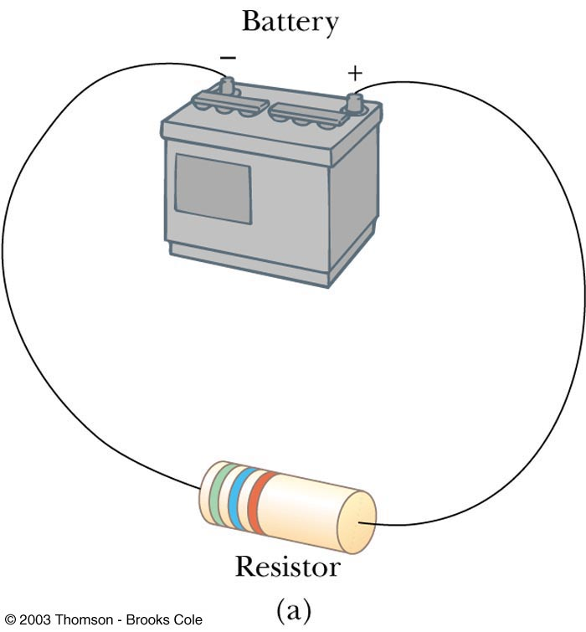
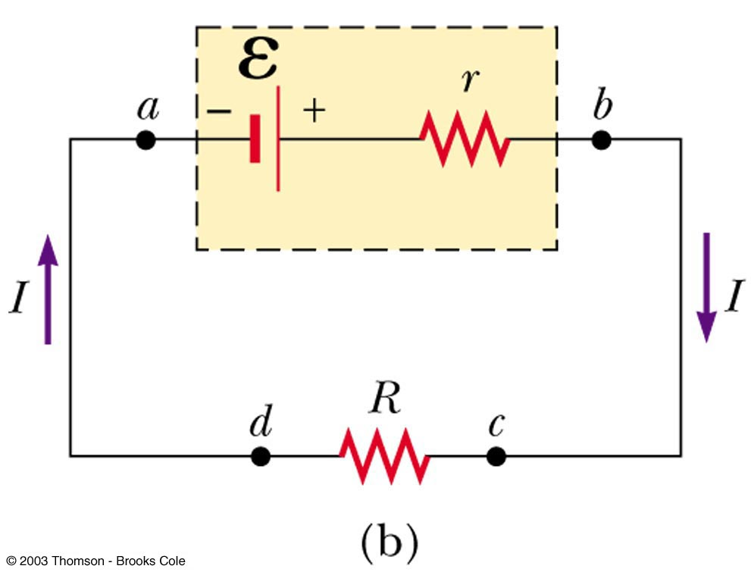
emf and Internal Resistance
A real battery has some internal resistance
Therefore, the terminal voltage is not equal to the emf

Slide 9
More About Internal Resistance
The schematic shows the internal resistance, r
The terminal voltage is ΔV = V_{b}-V_{a}
ΔV = ε – Ir
For the entire circuit, ε = IR + Ir

Slide 10
Internal Resistance and emf, cont
ε is equal to the terminal voltage when the current is zero
Also called the open-circuit voltage
R is called the load resistance
The current depends on both the resistance external to the battery and the internal resistance

Slide 11
Internal Resistance and emf, final
When R >> r, r can be ignored
Generally assumed in problems
Power relationship
I ε = I² R + I² r
When R >> r, most of the power delivered by the battery is transferred to the load resistor

Slide 12


RC Circuit
S
C
ΔV
R

Slide 13
RC Circuits
A direct current circuit may contain capacitors and resistors, the current will vary with time
When the circuit is completed, the capacitor starts to charge
The capacitor continues to charge until it reaches its maximum charge (Q = Cε)
Once the capacitor is fully charged, the current in the circuit is zero

Slide 14
Charging Capacitor in an RC Circuit
The charge on the capacitor varies with time
q = Q(1 – e^{-t/RC})
The time constant, τ=RC
The time constant represents the time required for the charge to increase from zero to 63.2% of its maximum

Slide 15
Notes on Time Constant
In a circuit with a large time constant, the capacitor charges very slowly
The capacitor charges very quickly if there is a small time constant
After t = 10 τ, the capacitor is over 99.99% charged

Slide 16
Discharging Capacitor in an RC Circuit
When a charged capacitor is placed in the circuit, it can be discharged
q = Qe-t/RC
The charge decreases exponentially
At t = τ = RC, the charge decreases to 0.368 Qmax
In other words, in one time constant, the capacitor loses 63.2% of its initial charge

Slide 17
Household Circuits
120V
Ground 0V
Meter
Circuit Breaker
Individual house switches
Individual house appliances

Slide 18
Household Circuits, cont.
A meter and a circuit breaker are connected in series with the wire entering the house
Wires and circuit breakers are selected to meet the demands of the circuit
If the current exceeds the rating of the circuit breaker, the breaker acts as a switch and opens the circuit
Household circuits actually use alternating current and voltage

Slide 19
Electrical Safety
Electric shock can result in fatal burns
Electric shock can cause the muscles of vital organs (such as the heart) to malfunction
The degree of damage depends on
the magnitude of the current
the length of time it acts
the part of the body through which it passes

Slide 20
Effects of Various Currents
5 mA or less
Can cause a sensation of shock
Generally little or no damage
10 mA
Hand muscles contract
May be unable to let go a of live wire
100 mA
If passes through the body for just a few seconds, can be fatal

Slide 21
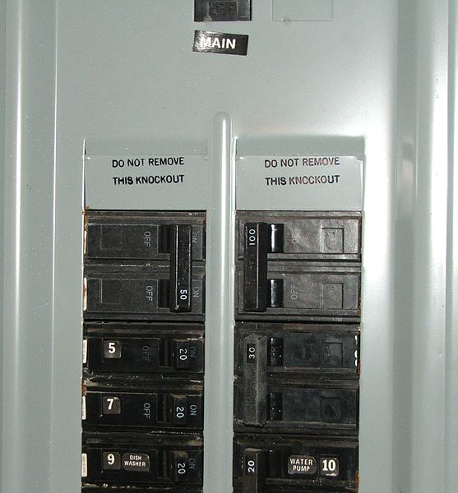
Ground Wire
Electrical equipment manufacturers use electrical cords that have a third wire, called a case ground
Prevents shocks

Slide 22
Ground Fault Interrupts (GFI)
Special power outlets
Used in hazardous areas
Designed to protect people from electrical shock
Senses currents (of about 5 mA or greater) leaking to ground
Shuts off the current when above this level

Slide 23
Electrical Signals in Neurons
Specialized cells in the body, called neurons, form a complex network that receives, processes, and transmits information from one part of the body to another
Three classes of neurons
Sensory neurons
Receive stimuli from sensory organs that monitor the external and internal environment of the body
Motor neurons
Carry messages that control the muscle cells
Interneurons
Transmit information from one neuron to another

Slide 24
Series Fluid Analogy
Upper Tank
ΔU₁
Middle Collection Tank
ΔU
ΔU₂
Pump
Lower Tank

Slide 25
Series Fluid Analogy
Upper Tank
ΔU₁
Flow meter
Middle Collection Tank
ΔU
ΔU₂
Pump
Lower Tank

Slide 26
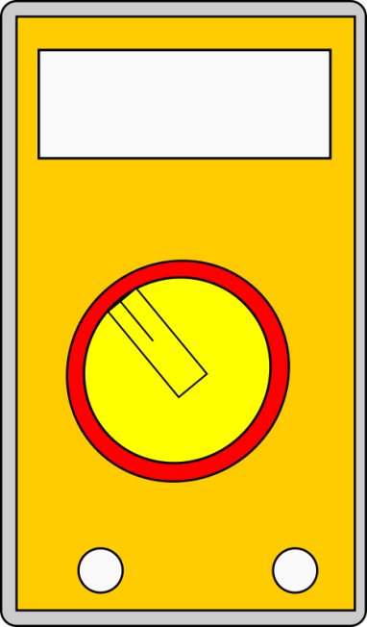
Meters

Slide 27
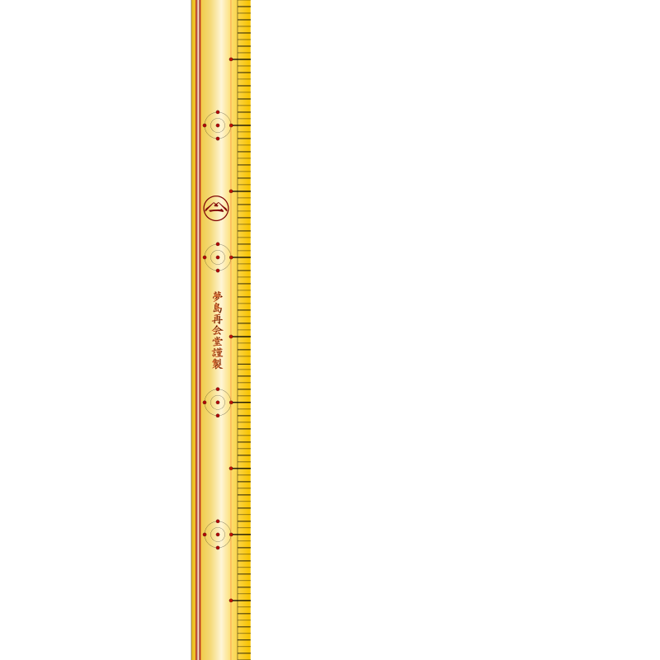
Series Fluid Analogy
Upper Tank
ΔU₁
Middle Collection Tank
ΔU
ΔU₂
Pump
Lower Tank

Slide 28
Meters

Slide 29
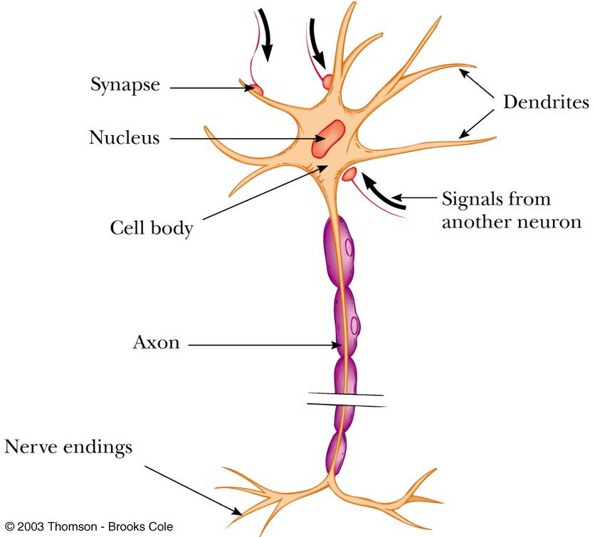
Diagram of a Neuron

Slide 30
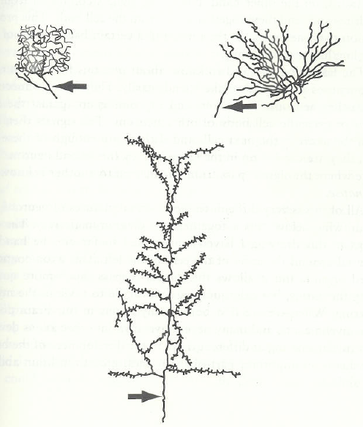
Axons
From James E. Zull, The Art of Changing the Brain, Stylus, Sterling Virginia, 2002

Slide 31
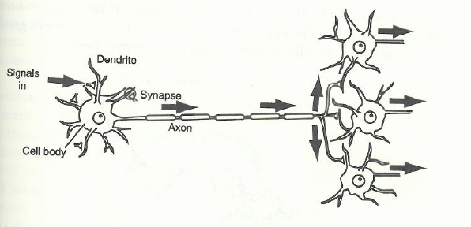
Signal Propagation
From James E. Zull, The Art of Changing the Brain, Stylus, Sterling Virginia, 2002

Slide 32
E
r
R

